Slide 1

DEPARTMENT OF COMPUTER SCIENCE Project Presentation (KCS 851) “Grievance Redressal System"
Guide Name: Prof. Pallavi Sharma(Assistant Professor)
Project Members :
1.Vishal Yadav 2000290120194(8C)
2.Yuvraj Narayan Mishra 2000290120200(8C)
3.Shruti Gautam 2000290120155(8C)

Slide 2
Problem Statement
In the context of India's progress towards cleanliness and digitalization, there's a need for a convenient grievance communication system regarding issues like cleanliness, drainage, and unauthorized construction. Current methods are hindered by long queues and limited service hours, leading to neglected problems and citizen disengagement. An online platform is required to facilitate easy reporting of issues, promoting citizen involvement and efficient problem-solving by authorities.

Slide 3
Objectives
To provide an easily accessible platform for online grievance submission from any location at any time.
To create a transparent process for tracking the status and progress of grievances by complainants and administrators.
To streamline the grievance handling process with automated workflows and notifications.
To establish clear communication channels between stakeholders and the grievance handling team for prompt responses and feedback.
To design a system that adheres to legal and regulatory requirements, ensuring confidentiality and privacy.

Slide 4
Project Scope
Secure Communication: Users can submit grievances and interact with authorities through a secure messaging system, ensuring confidentiality of sensitive information with end-to-end encryption.
Transparent Tracking: Users can track the status of their grievances transparently, with access to a public ledger or dashboard displaying the progress of complaints from submission to resolution, fostering accountability and trust.
Feedback Mechanism: Users are provided with avenues to provide feedback on the grievance redressal process, enabling continuous improvement and refinement of the system to better serve the needs of stakeholders.
User Authentication and Authorization: Robust authentication and authorization mechanisms are implemented to ensure that only authorized individuals can access and interact with the grievance redressal system, maintaining data security and privacy.
Offline Access: While real-time communication is prioritized, features for offline submission of grievances or accessing previously submitted complaints may be considered for future iterations to accommodate users with limited connectivity.

Slide 5
Technology Used
PHP(Backend)
JAVASCRIPT
HTML
CSS
BOOTSTRAP
DATABASE - MYSQL

Slide 6
Literature Survey
(1)
Paper Tittle : Adoption of online public grievance redressal system in India: Toward developing a unified view
Author Name : Nripendra P. Rana, Yogesh K. Dwivedi, Michael D. Williams, Vishanth Weerakkody
Journal Name : Computers in Human Behavior
Year of Publishing : 2016
Summary of Paper : The aim of this research is to develop a unified model of electronic government (e-government) system adoption and validate it using the data gathered from 419 citizens from few selected cities in India. In course of doing so, the research also evaluates the performance of nine well-known alternative theoretical models of information technology (IT) adoption including the unified theory of acceptance and use of technology (UTAUT). The results indicate that the proposed unified model for e-government adoption by this research has outperformed all other theoretical models by explaining highest 66% variance on behavioral intentions, adequately acceptable levels of fit indices, and significant relationships between each hypothesis. The research also provides its limitations and presents implications for theory and practice toward the end.

Slide 7
(2)
Paper Tittle : Examining factors affecting adoption of online public grievance redressal system: A case of India
Author Name : Rana, Nripendra, Michael Williams, and Yogesh Dwivedi
Journal Name : Association for Information Systems (AIS) eLibrary
Year of Publishing : 2013
Summary of Paper : The purpose of this paper is to examine the factors influencing the adoption of the online public grievance redressal system (OPGRS) in the Indian context. This e-government initiative is based on the government’s long term strategic policy that aims to reform and overhaul the Indian bureaucracy. The model developed is based on the unified theory of acceptance and use of technology (UTAUT) and includes the constructs including performance expectancy, effort expectancy, social influence, facilitating conditions, self-efficacy, and behavioral intention. The empirical outcomes provided the positive significant relationships for all 11 hypotheses established using six constructs. The empirical evidence and discussion presented in the study can help the Indian government to improve upon and fully utilize the potential of OPGRS as a useful tool for transparent and corruption free country. The research also provides its limitations and future research directions, and implications for theory and practice at the end.

Slide 8
(3)
Paper Tittle : Assessing grievances redressing mechanism in India
Author Name : Subhash Chander, Ashwani Kush
Journal Name : International Journal of Computer Applications
Year of Publishing : 2012
Summary of Paper: Various online services for the benefits of citizens are being provided by various states in India. Major aim of providing such services online is to empower the citizens. Major implementations regarding services for citizens in India include various acts for rights of human beings in democratic states. The major problem of today’s countries is corruption, bureaucracy and both are related with each other. There are so many grievances to all people residing in democratic countries like India. In Indian democratic structure Department of Administrative Reforms and Public Grievances (DARPG) is responsible for tackling the problems of grievances of various departments of different states and centre. In this paper four states and their grievance redressing system is taken into consideration. Various metrics related with the grievance portals have been considered and scale has been devised. The performance of all these four Indian states in grievance redress process has been measured on the scale. On the scale certain numerical values have been assigned for ten services as per their relevance for the citizens. Based on these values certain results have been shown in the graphical form. Various portals taken into account are HarSamadhan of Haryana, eSamadhan of Himachal Pradesh, SWAGAT of Gujarat and JanMitra of Karnatka.

Slide 9
(4)
Paper Tittle : Grievance Redressal in India during Pandemic and the Way Forward
Author Name : Abhinav Shahi
Journal Name : ASCI Journal of Management
Year of Publishing : 2022
Summary of Paper : In a fast-paced world like ours, which is already battling a pandemic, Grievance Redressal Mechanism (GRM) is the need of the hour. The Grievance Redressal Mechanism is an essential apparatus in any government or organizations’ toolkit to facilitate smooth functioning. From receiving complaints through a designated channel to redressal in an effective way, Grievance Redressal Mechanisms are inevitable in a world of rising technologies and reach henceforth. Grievance Redressal Mechanisms are dominating a major chunk of workflow not only nationally but internationally too. With the growing technologies and increasing digital literacy among the population, such mechanisms have improved with time, making it more accessible, user-friendly, and contactless. This paper aims to review the existing literature on the issue and look for recent on-field examples wherein states like Kerala, Himachal Pradesh and Bihar have performed exceptionally in e-governance innovations during the pandemic. Alongside some remarkable achievements, there have been some crucial challenges too. These include the ability of such mechanisms among general public and bridging the digital divide in our country. This paper also aims to find solutions to these problems to progress towards a better future for all.

Slide 10
(5)
Paper Tittle : Does e‐service quality of online grievance redress portals lead to satisfaction? An outlook from the perspectives of Indian youth
Author Name : Anil Kumar, Amit Anand Tiwari, Rohit Kumar Singh, Tirthankar Nag
Journal Name : Journal of Public Affairs
Year of Publishing : 2023
Summary of Paper : In India, citizens expect quality public services, including information technology-enabled versions. To increase citizen satisfaction, countries worldwide aim to develop transparent and accountable online systems. This study aimed to assess the e-service quality of an online grievance redress portal for student users. A survey of 677 respondents was conducted using partial least squares structural equation modeling. Results showed that security and privacy are crucial for student satisfaction, as they build trust in the online e-governance system. Reliability and quality of information delivery were also important. Gender did not significantly affect student satisfaction with e-government services. The study's limitations and future research scope are also presented.

Slide 11
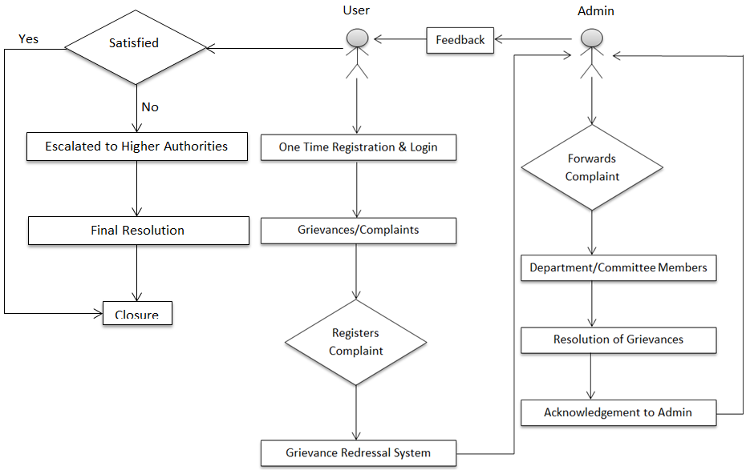
Workflow Diagram

Slide 12
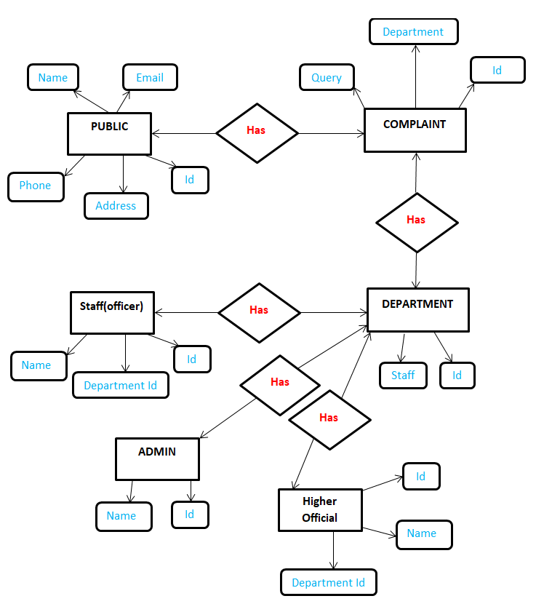
ER Diagram

Slide 13
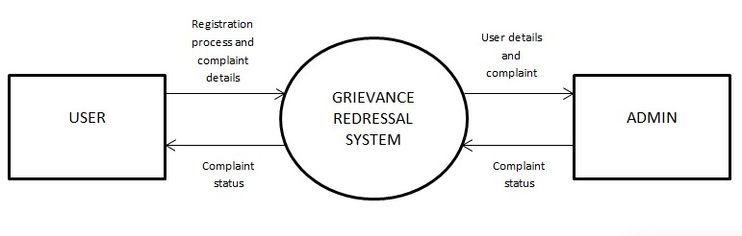
DFD LEVEL 0

Slide 14
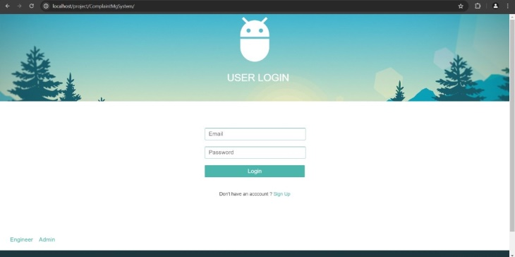
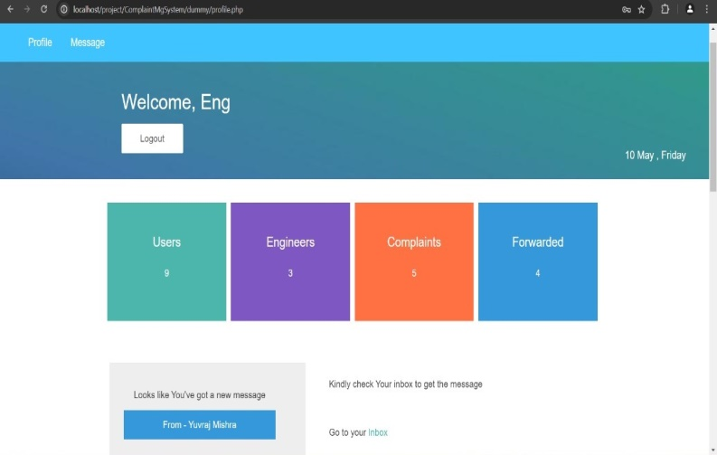
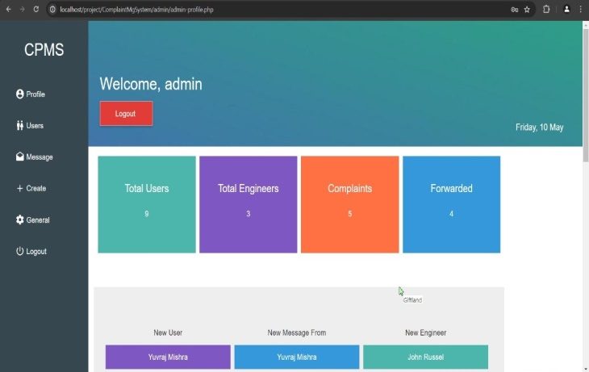
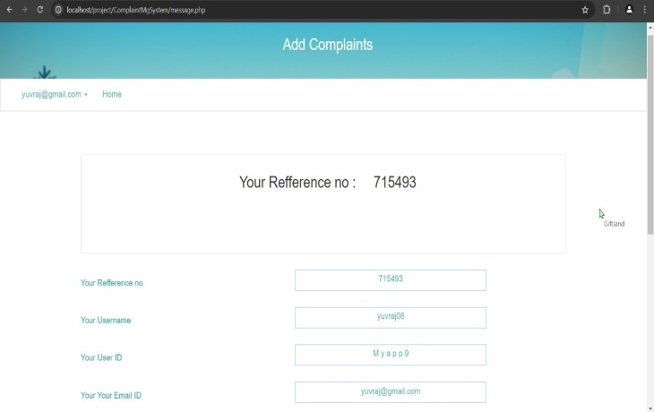
Project Status : 100% Completed
GitHub Link of Project : https://github.com/YuvrajNarayanMishra/GrievanceRedressalSystem.git

Slide 15
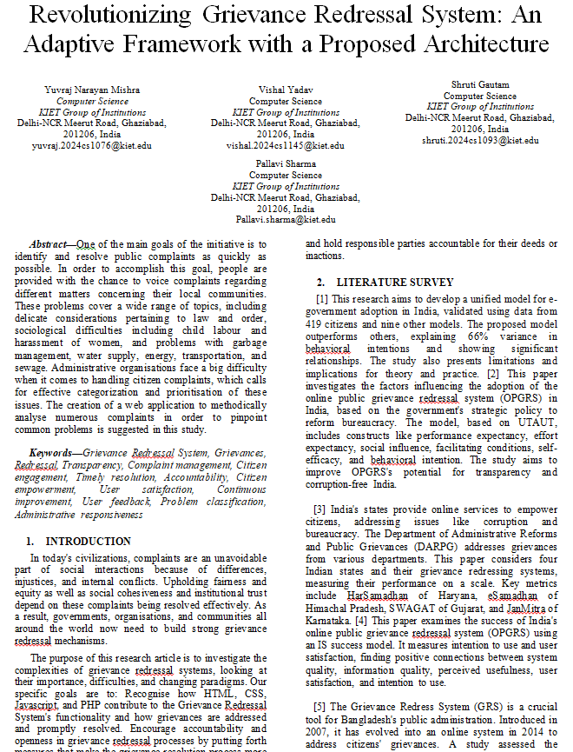
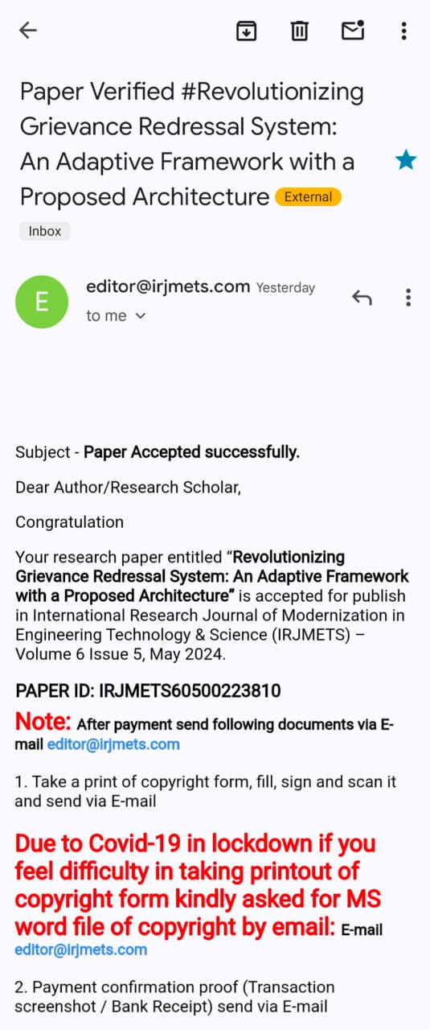
Research Paper Status : Accepted
Hyperlink of paper : https://drive.google.com/file/d/1MIFn0pTpW0PgeCbWVpfzdkF_0RVVOWJY/view?usp=drivesdk

Slide 16
Future Work
Mobile Application Development: Developing dedicated mobile applications for online grievance redressal systems can improve accessibility and user experience, allowing individuals to submit and track grievances conveniently from their smartphones.
Blockchain Technology: Utilizing blockchain technology for secure and transparent record-keeping of grievance-related data could enhance trust and transparency in the grievance redressal process.
Offline Functionality: Develop a robust offline complaint registering system, allowing users to register complaints even in low or no internet connevtivity scenarios, ensuring uninterrupted communication.

Slide 17
All documents Proofs (Github and Drive)
Hyperlink of the testing report : https://drive.google.com/file/d/1_pZKevytdFh7srJAbqG4oCHkyMDsRcYL/view?usp=drive_link
Hyperlink of the Synopsis : https://drive.google.com/file/d/1zPPJWCzDnohyzsfjVg59B4DowcO_MM3x/view?usp=drive_link
Hyperlink of the SRS : https://drive.google.com/file/d/1M6qEuV7gw5udKAt2RvpxGG34iofHTeQw/view?usp=drive_link
Hyperlink of Report : https://drive.google.com/file/d/1LjkuXnB_0WajXaUeErkkq5M6ivH7Zo5_/view?usp=drive_link
Github Link : https://github.com/YuvrajNarayanMishra/CS-2024-C/tree/main/PCS24-71-Yuvraj

Slide 18
References
[1] Rana, Nripendra P., et al. "Adoption of online public grievance redressal system in India: Toward developing a unified view." Computers in Human Behavior 59 (2016): 265-282.
[2] Rana, Nripendra, Michael Williams, and Yogesh Dwivedi. "Examining factors affecting adoption of online public grievance redressal system: A case of India." (2013).
[3] Rana, Nripendra P., Yogesh K. Dwivedi, and Michael D. Williams. "Examining the factors affecting intention to use of, and user satisfaction with online public grievance redressal system (OPGRS) in India." Grand Successes and Failures in IT. Public and Private Sectors: IFIP WG 8.6 International Working Conference on Transfer and Diffusion of IT, TDIT 2013, Bangalore, India, June 27-29, 2013. Proceedings. Springer Berlin Heidelberg, 2013.
[4] Chowdhury, Md Shahidul Islam. "Strengthening Grievance Redress System: A Case of Narsingdi District Administration." angladesh ournal of ublic dministration 31.1 (2023): 23-46.
[5] Shettigar, Rakshitha, et al. "Blockchain-Based Grievance Management System." Evolution in Computational Intelligence: Frontiers in Intelligent Computing: Theory and Applications (FICTA 2020), Volume 1. Springer Singapore, 2021.
[6] Chander, Subhash, and Ashwani Kush. "Assessing grievances redressing mechanism in India." International Journal of Computer Applications 52.5 (2012).

Slide 19
[7] Prajapat, Shaligram, Vaibhav Sabharwal, and Varun Wadhwani. "A prototype for grievance redressal system." Proceedings of International Conference on Recent Advancement on Computer and Communication: ICRAC 2017. Springer Singapore, 2018.
[8] Shahi, Abhinav. "Grievance Redressal in India during Pandemic and the Way Forward." ASCI Journal of Management 51.1 (2022).
[9] Aravindhan, K., et al. "Web Portal for Effective Student Grievance Support System." 2020 6th International Conference on Advanced Computing and Communication Systems (ICACCS). IEEE, 2020.
[10] Rana, Nripendra P., et al. "An extended DeLone and McLean's information system model for examining success of online public grievance redressal system in Indian context." International Journal of Indian Culture and Business Management 10.3 (2015): 267-290.
[11] Kumar, Anil, et al. "Does e‐service quality of online grievance redress portals lead to satisfaction? An outlook from the perspectives of Indian youth." Journal of Public Affairs 23.1 (2023): e2822.

